Slide 1

CSV file (resource & sdcard)

Slide 2
Đọc & Ghi file (CSV)
Opencsv is an easy-to-use CSV (comma-separated values) parser library for Java. It was developed because all the CSV parsers at the time didn’t have commercial-friendly licenses. Java 7 is currently the minimum supported version.
First, add this package to your build.gradle (app) dependencies as follows
Then, import it
AndroidManifest.xml
implementation 'com.opencsv:opencsv:4.5'
import com.opencsv.CSVReader; import java.io.IOException; import java.io.FileReader;
<uses-permission android:name="android.permission.READ_EXTERNAL_STORAGE"/> <uses-permission android:name="android.permission.WRITE_EXTERNAL_STORAGE"/>

Slide 3
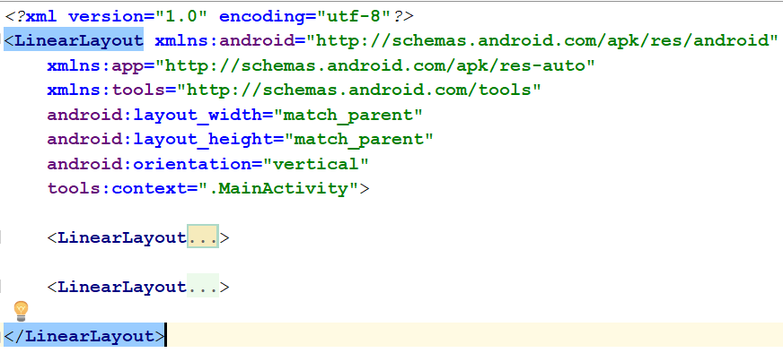
Đọc & Ghi file (CSV)
MainActivity

Slide 4
Đọc & Ghi file (CSV)
<LinearLayout android:layout_width="match_parent" android:layout_height="wrap_content"> <TextView android:layout_width="wrap_content" android:layout_height="wrap_content" android:text="Chọn nơi lưu file!" app:layout_constraintBottom_toBottomOf="parent" app:layout_constraintLeft_toLeftOf="parent" app:layout_constraintRight_toRightOf="parent" app:layout_constraintTop_toTopOf="parent" /> <Button android:id="@+id/btnRes" android:layout_width="wrap_content" android:layout_height="wrap_content" android:text="Resource"/> <Button android:id="@+id/btnStorage" android:layout_width="wrap_content" android:layout_height="wrap_content" android:text="Storage"/> </LinearLayout>
MainActivity
<Button android:id="@+id/btnSave" android:layout_width="wrap_content" android:layout_height="wrap_content" android:text="Save"/>
<LinearLayout android:layout_width="match_parent" android:layout_height="match_parent"> <ListView android:id="@+id/lst" android:layout_width="match_parent" android:layout_height="match_parent"> </ListView> </LinearLayout>

Slide 5
Đọc & Ghi file (CSV)
List Item Layout (list_item.xml)
<LinearLayout xmlns:android="http://schemas.android.com/apk/res/android"
android:layout_width="match_parent" android:layout_height="match_parent"
android:orientation="vertical"> <TextView android:id="@+id/txtHoTen" android:layout_width="match_parent" android:layout_height="wrap_content" android:textColor="@android:color/holo_red_dark" android:textStyle="bold"
android:textSize="12pt"/> </LinearLayout>
<LinearLayout android:layout_width="match_parent" android:layout_height="wrap_content" android:orientation="horizontal"> <TextView android:id="@+id/txtMaSo" android:layout_width="wrap_content" android:layout_height="match_parent" android:textColor="@android:color/holo_blue_dark" android:textSize="8pt"/> <TextView android:id="@+id/txtNgayGio" android:layout_width="wrap_content" android:layout_height="match_parent" android:textColor="@android:color/holo_purple" android:textSize="8pt"/> </LinearLayout>

Slide 6
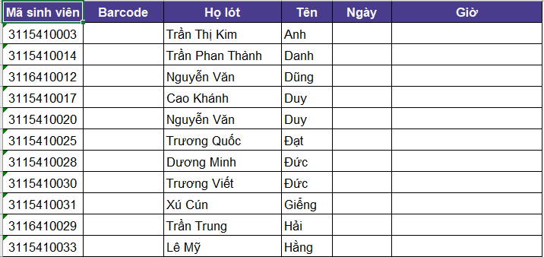
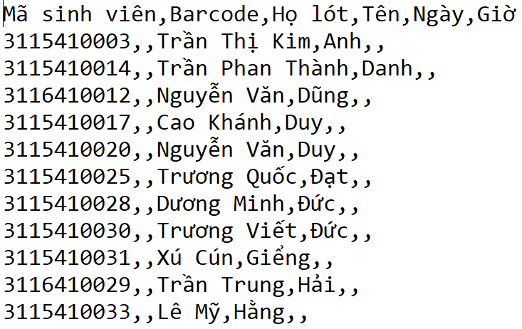
Đọc & Ghi file (CSV)
CSV file

Slide 7
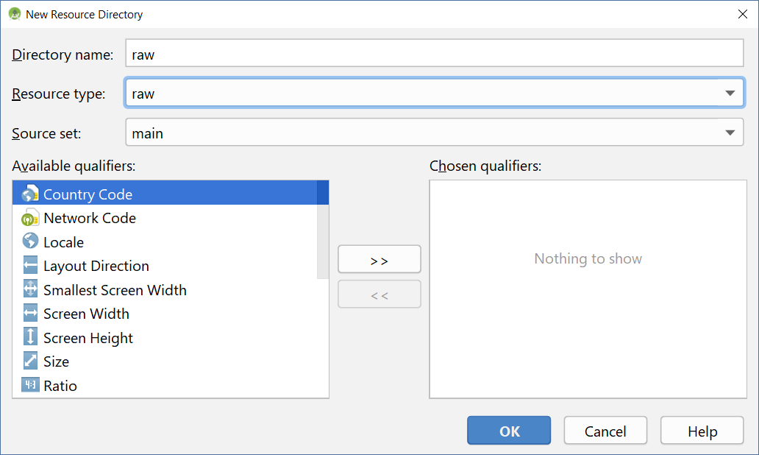
Đọc & Ghi file (CSV)
Sau khi thêm Resource Directory, copy & paste file danh sách vào res/raw

Slide 8
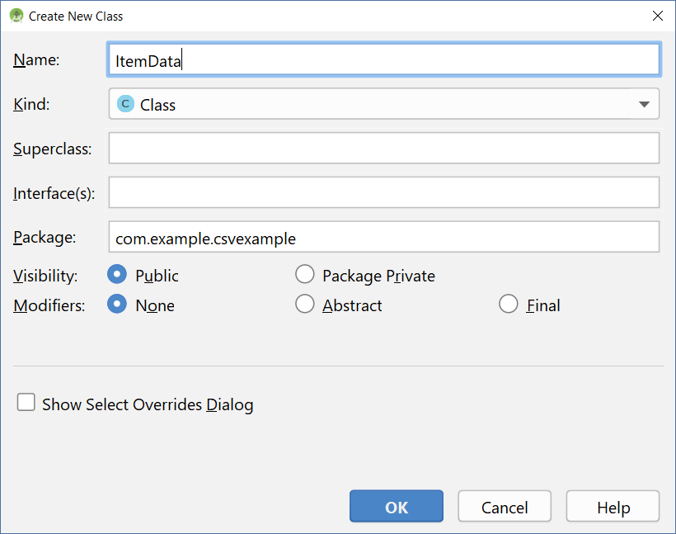
Đọc & Ghi file (CSV) – ItemData class

Slide 9
Đọc & Ghi file (CSV) – ItemData class
public class ItemData { public String maso, mavach, holot, ten, ngay, gio; public ItemData(String maso, String mavach, String holot, String ten, String ngay, String gio) { this.maso = maso; this.mavach = mavach; this.holot = holot; this.ten = ten; this.ngay = ngay; this.gio = gio; } }

Slide 10
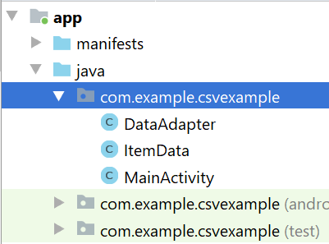
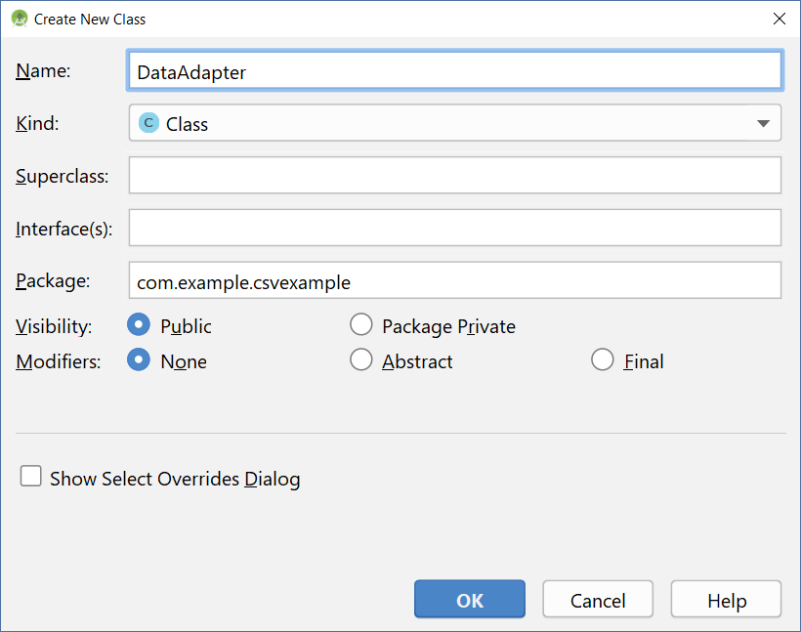
Đọc & Ghi file (CSV) – DataAdapter class

Slide 11
Đọc & Ghi file (CSV) – DataAdapter class
public class DataAdapter extends ArrayAdapter<ItemData> { Context context; List<ItemData> items; public DataAdapter(Context context,
int layoutTobeInflated, List<ItemData> items) { super(context, R.layout.list_item, items); this.context = context; this.items = items;
}

Slide 12
Đọc & Ghi file (CSV) – DataAdapter class
@Override public View getView(int position, View convertView, ViewGroup parent) { LayoutInflater inflater = ((Activity) context).getLayoutInflater(); View row = inflater.inflate(R.layout.list_item, null); TextView tvHoTen = (TextView)row.findViewById(R.id.txtHoTen); TextView tvMaSo = (TextView)row.findViewById(R.id.txtMaSo); TextView tvNgayGio = (TextView)row.findViewById(R.id.txtNgayGio); tvHoTen.setText(items.get(position).holot + " " + items.get(position).ten); tvMaSo.setText(items.get(position).maso); tvNgayGio.setText(items.get(position).ngay + " - " + items.get(position).gio); return row; }

Slide 13
Đọc & Ghi file (CSV) – MainActivity
Button btnStorage, btnResource, btnSave; ListView lst; List<ItemData> items; DataAdapter adapter;
Boolean isRes;
@Override protected void onCreate(Bundle savedInstanceState) { super.onCreate(savedInstanceState); setContentView(R.layout.activity_main); btnStorage = (Button) findViewById(R.id.btnStorage); btnResource = (Button)findViewById(R.id.btnRes); btnSave = (Button)findViewById(R.id.btnSave); lst = (ListView)findViewById(R.id.lst); isRes = true; items = prepareData(); adapter = new DataAdapter(this, R.layout.list_item, items); lst.setAdapter(adapter); btnStorage.setOnClickListener(new View.OnClickListener() { @Override public void onClick(View v) { isRes = false; items = loadFile(); adapter = new DataAdapter(v.getContext(), R.layout.list_item, items); lst.setAdapter(adapter); } });
private static final String DATE_FORMAT = "dd/MM/yyyy"; private static final String TIME_FORMAT_12 = "hh:mm:ss a"; private static final String TIME_FORMAT_24 = "HH:mm:ss";

Slide 14
Đọc & Ghi file (CSV) – MainActivity
btnResource.setOnClickListener(new View.OnClickListener() { @Override public void onClick(View v) { isRes = true; items = prepareData(); adapter = new DataAdapter(v.getContext(), R.layout.list_item, items); lst.setAdapter(adapter); } }); btnSave.setOnClickListener(new View.OnClickListener() { @Override public void onClick(View v) { saveData(); } }); lst.setOnItemClickListener(new AdapterView.OnItemClickListener() { @Override public void onItemClick(AdapterView<?> parent, View view, int position, long id) { kiemDien(view, position); } }); }

Slide 15
Đọc & Ghi file (CSV) – MainActivity
private List<ItemData> prepareData() { InputStream is = getResources().openRawResource(R.raw.dssv); BufferedReader reader = new BufferedReader(new InputStreamReader(is, Charset.forName("Unicode"))); CSVReader csvReader = new CSVReader(reader); ArrayList<ItemData> lstItems = new ArrayList<>(); String[] nextLine; try { while ((nextLine = csvReader.readNext()) != null) { // nextLine[] is an array of values from the line if (nextLine.length != 6) continue; ItemData item = new ItemData(nextLine[0], nextLine[1], nextLine[2], nextLine[3], nextLine[4], nextLine[5]); lstItems.add(item); } } catch(IOException e){ //e.printStackTrace(); Toast.makeText(this, e.getMessage().toString(), Toast.LENGTH_SHORT).show(); } return lstItems; }

Slide 16
Đọc & Ghi file (CSV) – MainActivity
private List<ItemData> loadFile() { File csvfile; BufferedReader reader; CSVReader csvReader; ArrayList<ItemData> lstItems = new ArrayList<>(); String[] nextLine; try { csvfile = new File(Environment.getExternalStorageDirectory() + "/dssv.csv"); FileInputStream fis = new FileInputStream(csvfile); reader = new BufferedReader(new InputStreamReader(fis, Charset.forName("Unicode"))); csvReader = new CSVReader(reader); while ((nextLine = csvReader.readNext()) != null) { // nextLine[] is an array of values from the line if (nextLine.length != 6) continue; ItemData item = new ItemData(nextLine[0], nextLine[1], nextLine[2], nextLine[3], nextLine[4], nextLine[5]); lstItems.add(item); } } catch(IOException e){ //e.printStackTrace(); Toast.makeText(this, e.getCause().toString() + ": " + e.getMessage().toString(), Toast.LENGTH_SHORT).show(); } return lstItems; }

Slide 17
Đọc & Ghi file (CSV) – MainActivity
private void kiemDien(View view, int position) { Date d = new Date(); items.get(position).ngay = (new SimpleDateFormat(DATE_FORMAT)).format(d); items.get(position).gio = (new SimpleDateFormat(TIME_FORMAT_24)).format(d); lst.setAdapter(adapter); }
private void saveData() { try { if (isRes == true) { Toast.makeText(this, "Resource không thể ghi trong run-time", Toast.LENGTH_SHORT).show(); } else { CSVWriter csvWriter = new CSVWriter(new OutputStreamWriter(
new FileOutputStream(this.getFilesDir().getAbsolutePath() + "/dssv.csv"), "UTF-8")); for (ItemData item : items) { String[] line = new String[]{item.maso, item.mavach, item.holot, item.ten, item.ngay, item.gio}; csvWriter.writeNext(line); } csvWriter.close(); Toast.makeText(this, "Saved", Toast.LENGTH_SHORT).show(); } } catch (IOException e) { Toast.makeText(this, e.getCause().toString() + ": " + e.getMessage().toString(), Toast.LENGTH_SHORT).show(); } }

Slide 18

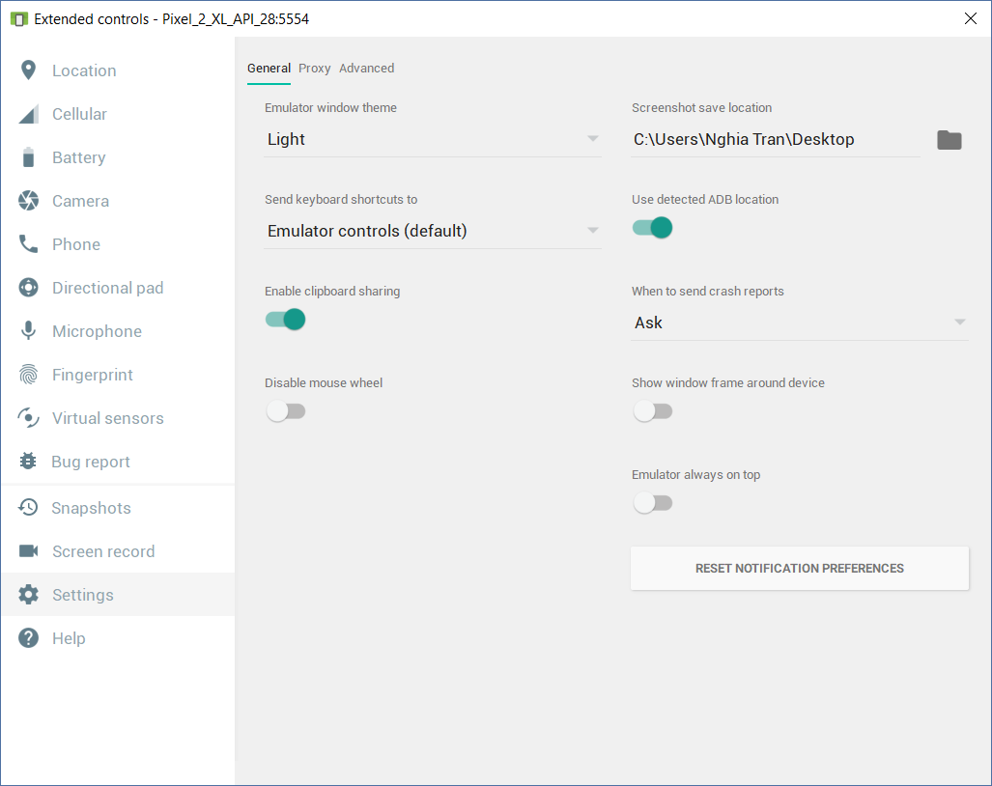
Đọc & Ghi file (CSV) – Copy file to device
Kéo thả file vào device
Được lưu trong Download
Dùng File trong device để di chuyển file vào gốc sdcard

Slide 19
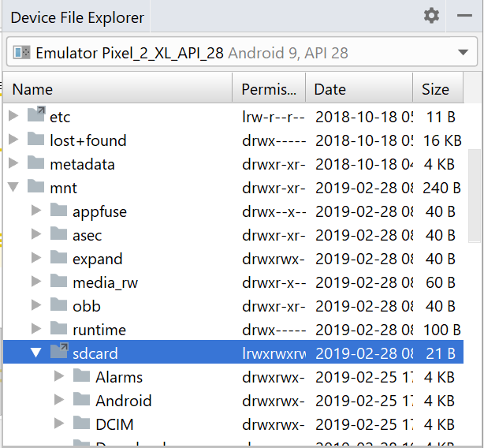
Đọc & Ghi file (CSV) – Copy file to device
Click chọn Device File Explorer góc phải dưới Android Studio
Chọn mnt / sdcard
Click phải sdcard, chọn Upload…
Dẫn đến file dssv.csv

Slide 20
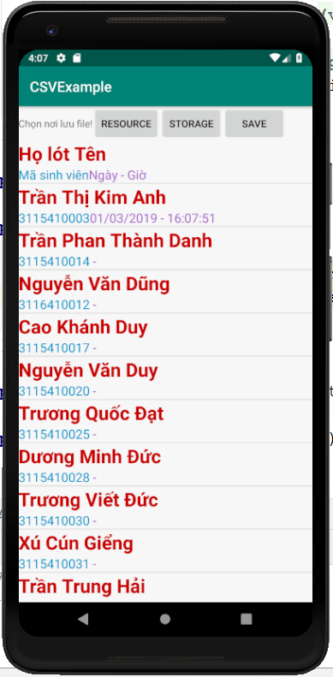
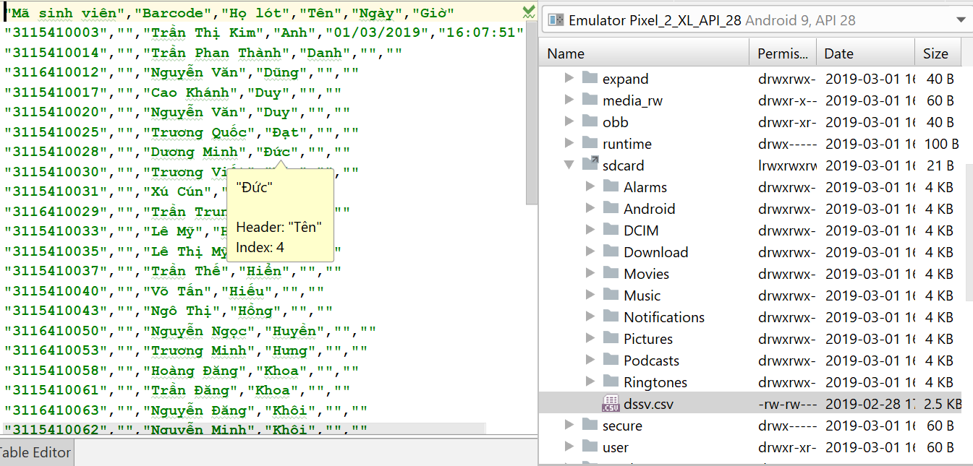
Chạy thử

